Slide 1



2
0
20
Project on data analysis
Market report for Customer and Product Analysis
SUPPORTED BY KPGM
This presentation is created to show the data analysis done by me on Market report for Customer and Product Analysis.
Refer Analysis

Slide 2
3
DashBoarding
2
LEARNING
1
ANALYTICS

Slide 3
Source of data
The data set used in this project is provided by KPMG.

Slide 4
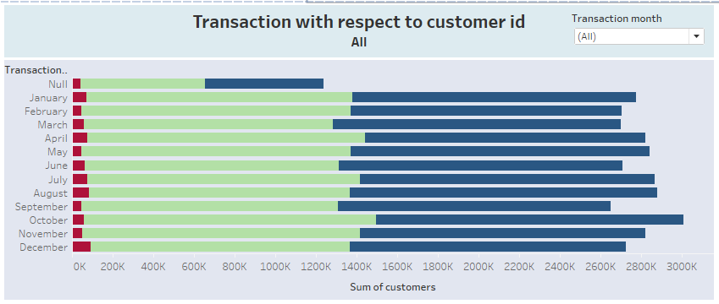
Transaction with respect to Customer ID
The below graph shows the Transactions for every months which is segregated by genders.
Factors are:-
Transaction
Customer IDs
Gender (Blue-Male, Green-Female, Red-Unisex)

Slide 5
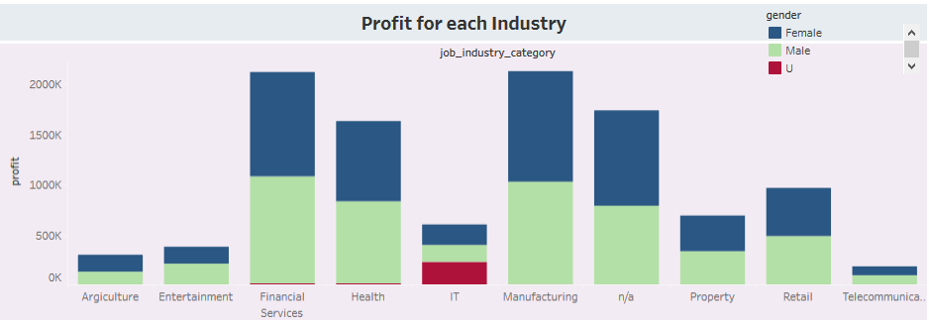
Profit for each industry
The representation on the graph shows the Profit for each industry with respect to gender working.
2,116,976
101,960
Telecommunication
Manufacturing

Slide 6
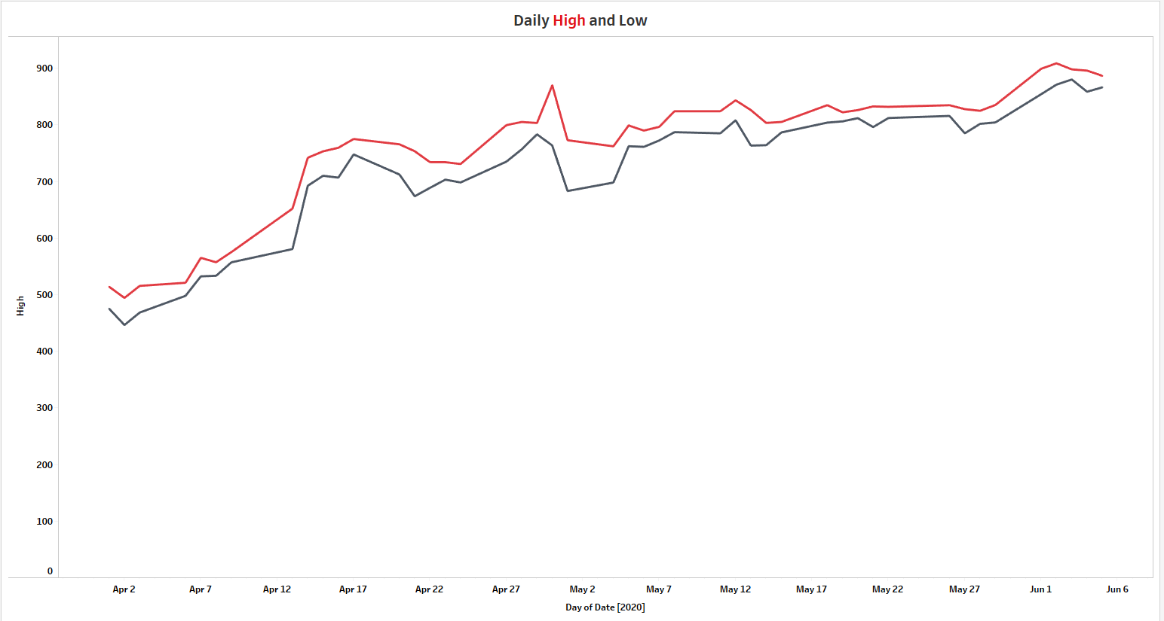
Daily High and Low
The below representation on the graph shows the Highest and Lowest Daily Price
Return

Slide 7
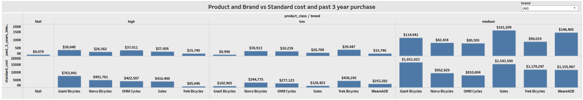
Product and Brand vs Past 3 year purchase
And Standard cost
The below representation on the graph shows the price for each brand sold by the company with there respective standard cost.

Slide 8
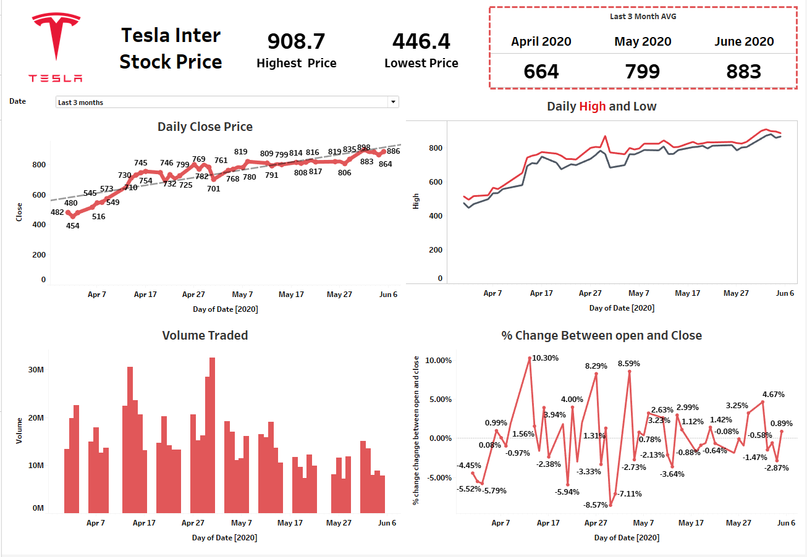

Slide 9
Thank You
Refer Dashboard…….
Tableau dashboard link :- https://public.tableau.com/profile/yash.rao#!/vizhome/KPMGvirtualinternship_15937011241320/KMPGvertualinternship
Made By – A. Yash Kumar Rao

